Slide 1
Collaboration with OpenProject
Team Members: Patel Meet, Aagam Shah, Mistry Akash, Patel Rishi
Date: Aug-13-2024

Slide 2
Introduction
This presentation covers the setup and configuration process for the project 'Collaboration with OpenProject’.
Represent how different Operating Systems can collaborate for the same project.
LDAP: Linux System (Cent OS) integration with Active Directory.
Users can access the tool for same project.

Slide 3
Project Overview
Objectives:
- Install and configure OpenProject
- Ensure proper functionality
Team Roles:
- Patel Meet (Leader)
- Aagam Shah
- Mistry Akash
- Patel Rishi

Slide 4
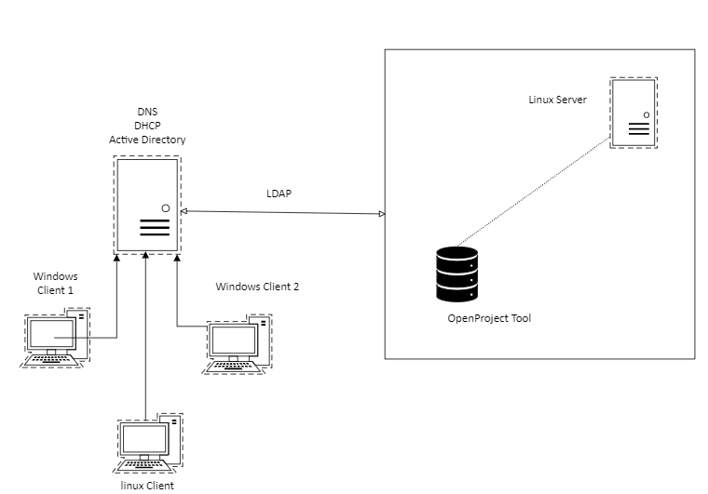
Project Diagram

Slide 5
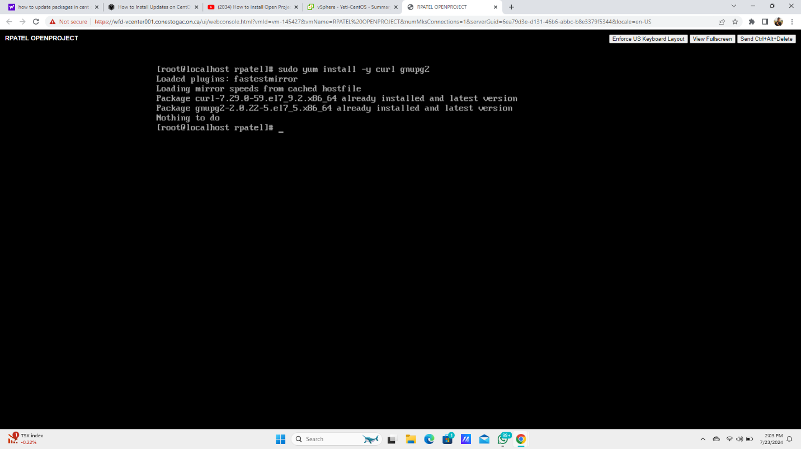
Setup and Configuration
Installing Required Packages
Curl is used for downloading command line tools files from the Web.
Gnupg2 is used for encryption and sign-in.

Slide 6
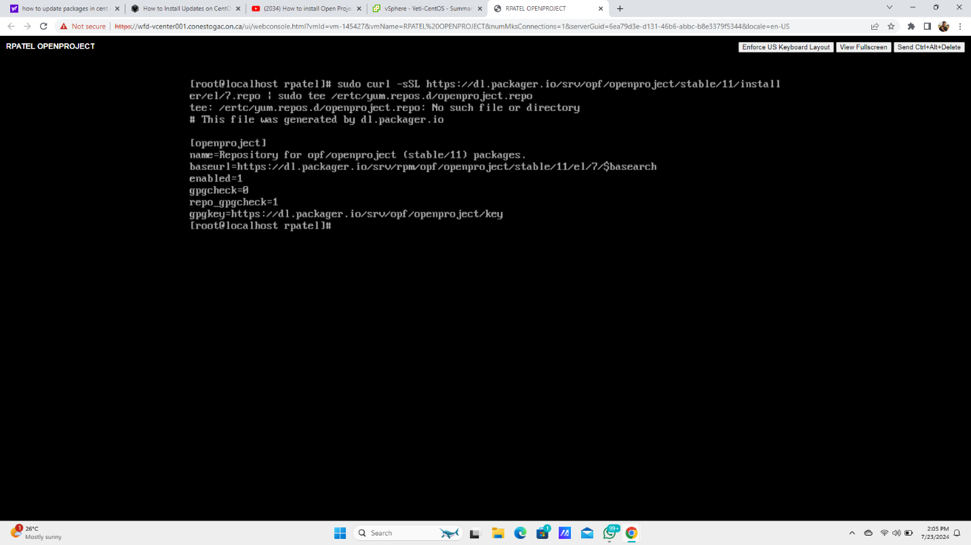
Setup and Configuration
Adding OpenProject Repository
OpenProject provides a repository configuration package that makes easy to update and installation of project

Slide 7
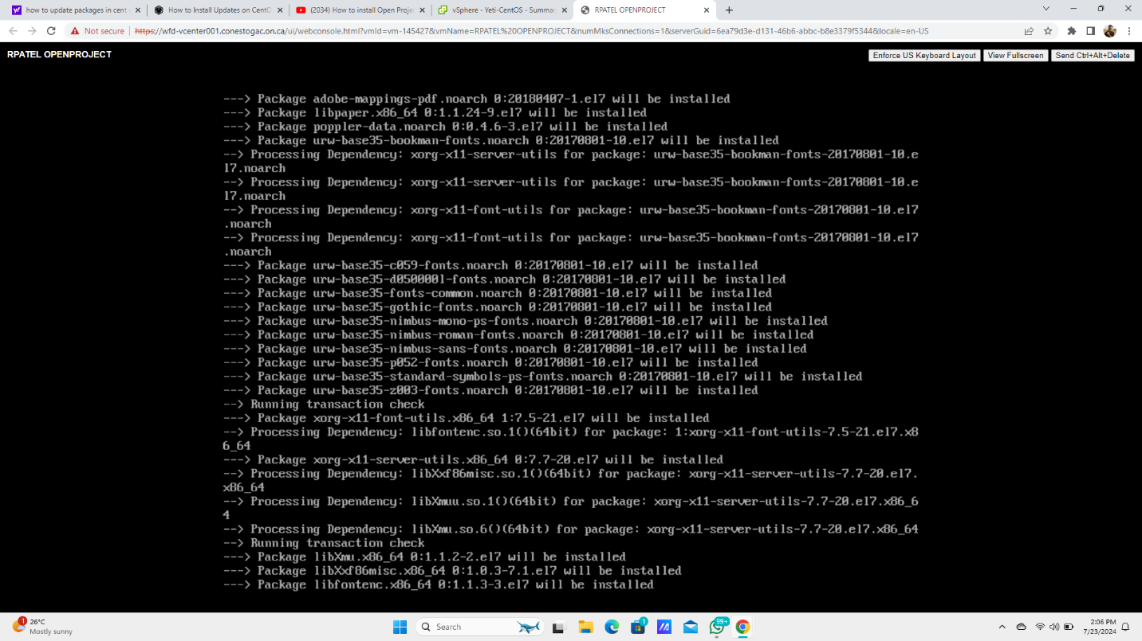
OpenProject Installation
Installing OpenProject

Slide 8
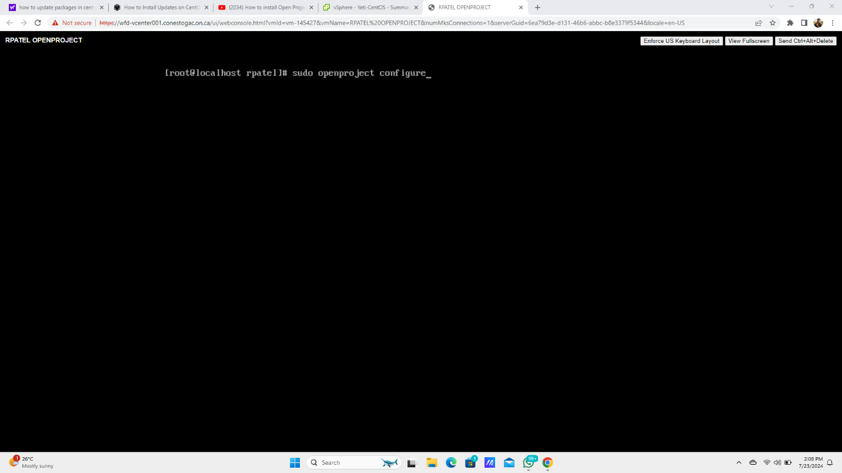
OpenProject Installation
OpenProject Initial Configuration
This process contains Database(MySQL),
SMTP
Web server(Apache)

Slide 9
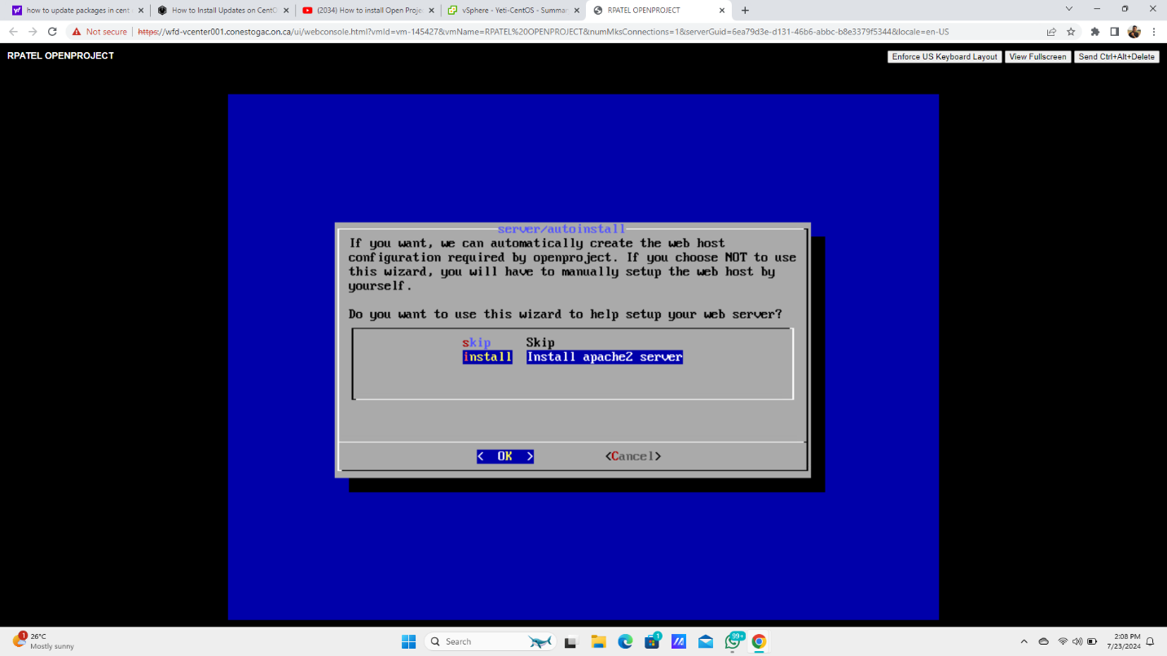
Service Configurations
Configuring Apache2 Server

Slide 10
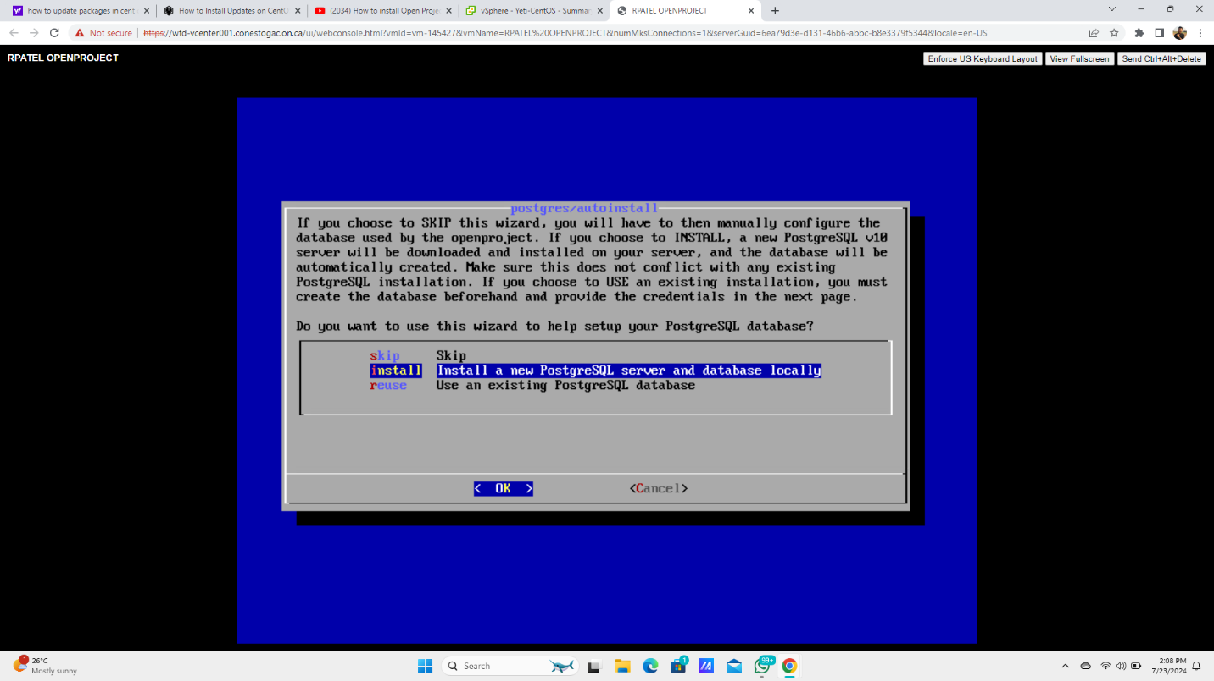
Service Configurations
Setting Up PostgreSQL Database
It stores each user’s details, username and Password

Slide 11
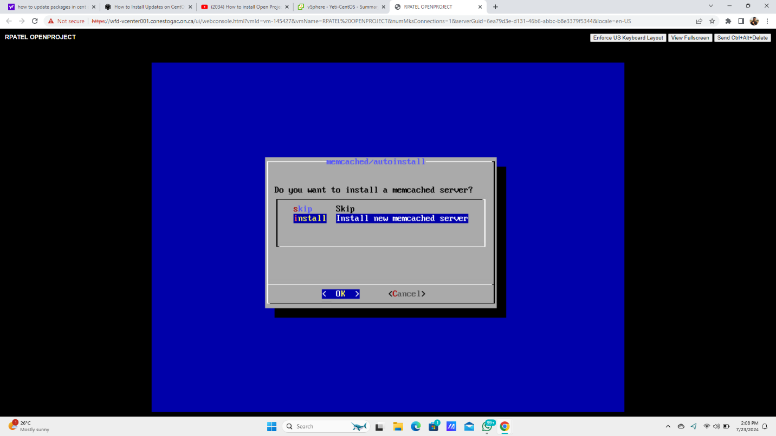
Service Configurations
Configuring Memcached Server

Slide 12
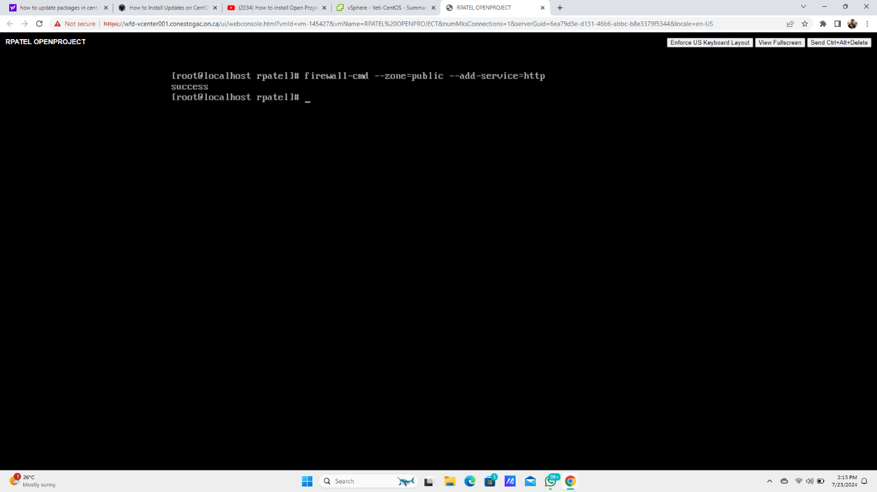
Service Configurations
Adding HTTP Service to Firewall
Enabling a firewall opens some necessary ports that help to access the server from outside the network.

Slide 13
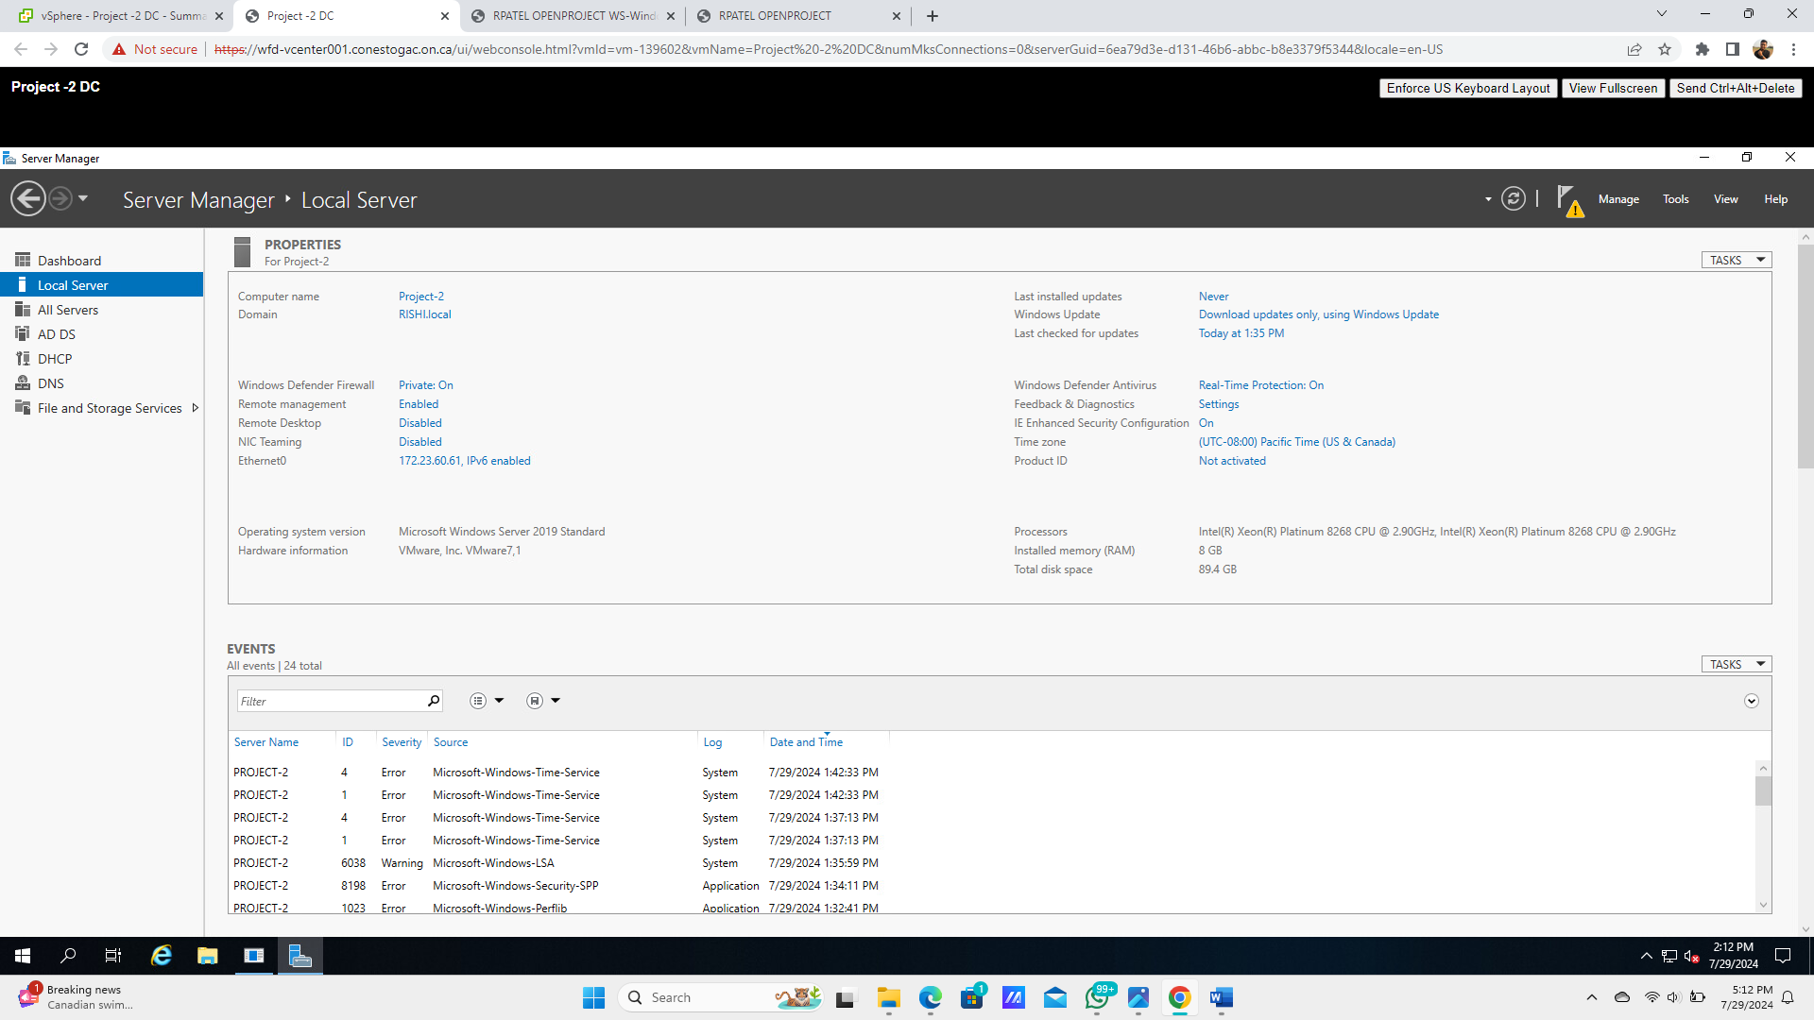
Domain and User Management
Setting Up Domain Controller
It is responsible for storing cache.
It typically contains environmental variables

Slide 14
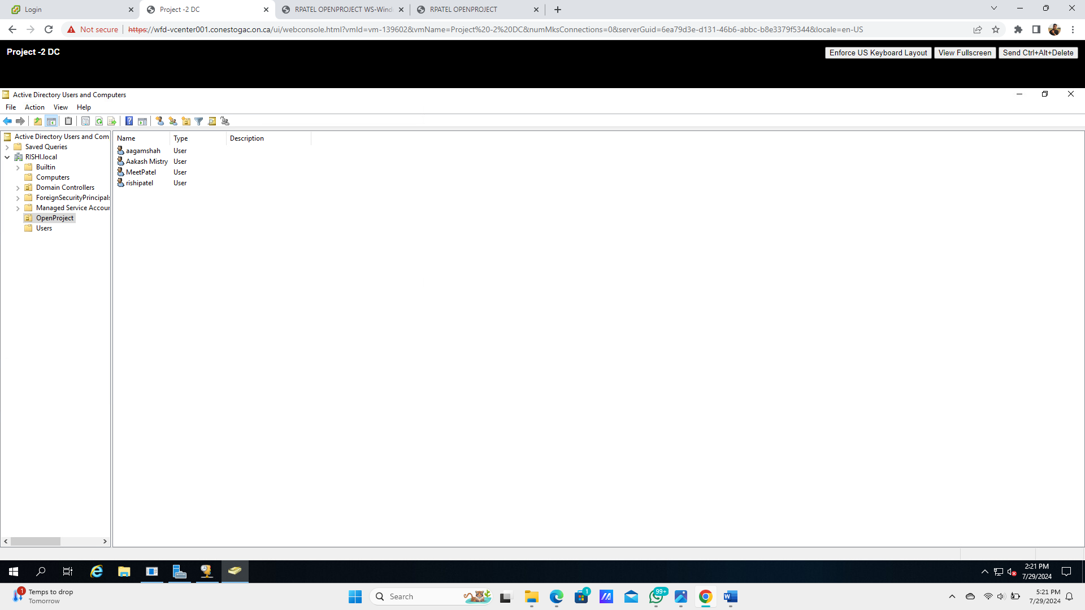
Domain and User Management
Creating User Accounts in Active Directory
Domain Controller is required for security consistency and efficiency of User Data.
Required for LDAP configurations.

Slide 15
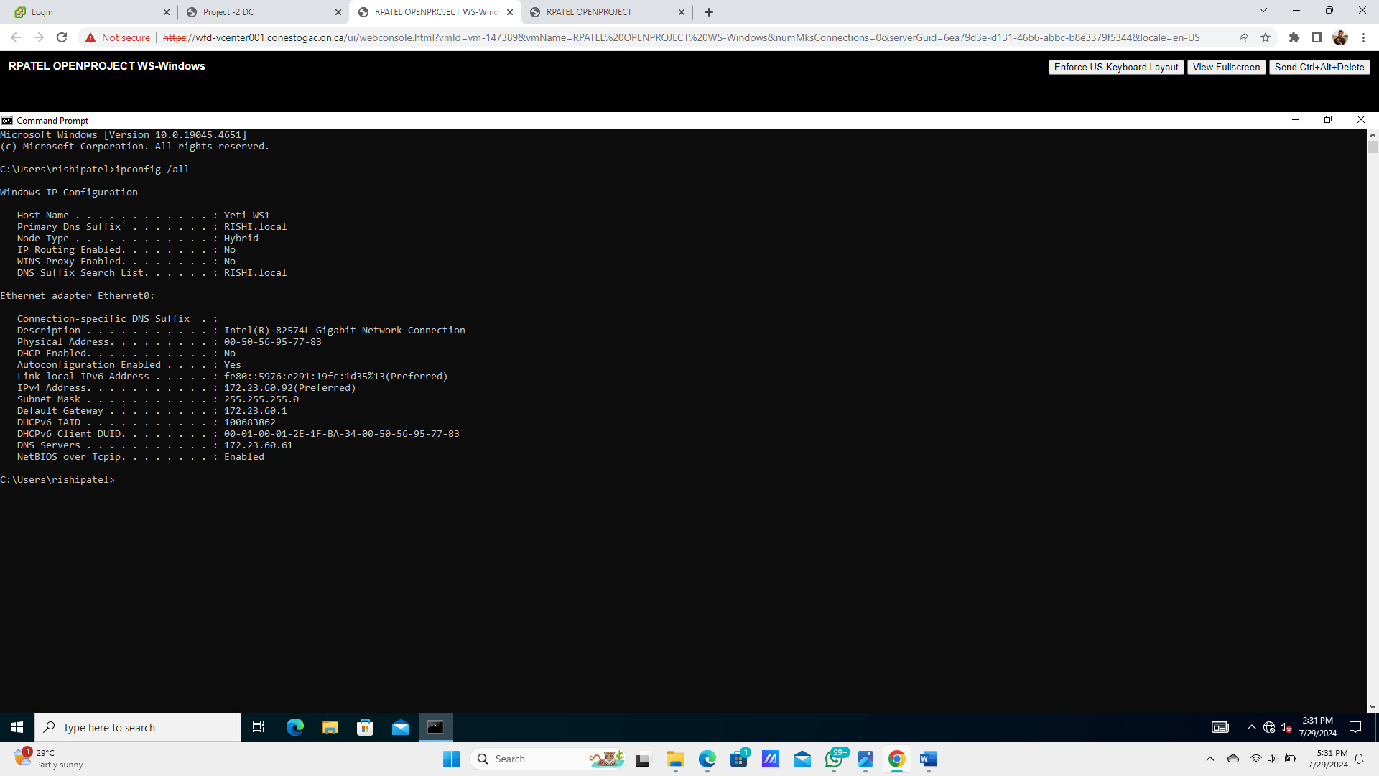
Network Configuration
Verifying Network Settings on Windows Client Machine
The Client Machine is ready with appropriate network configurations.
From here, the user can log in and use the Openproject tool.

Slide 16
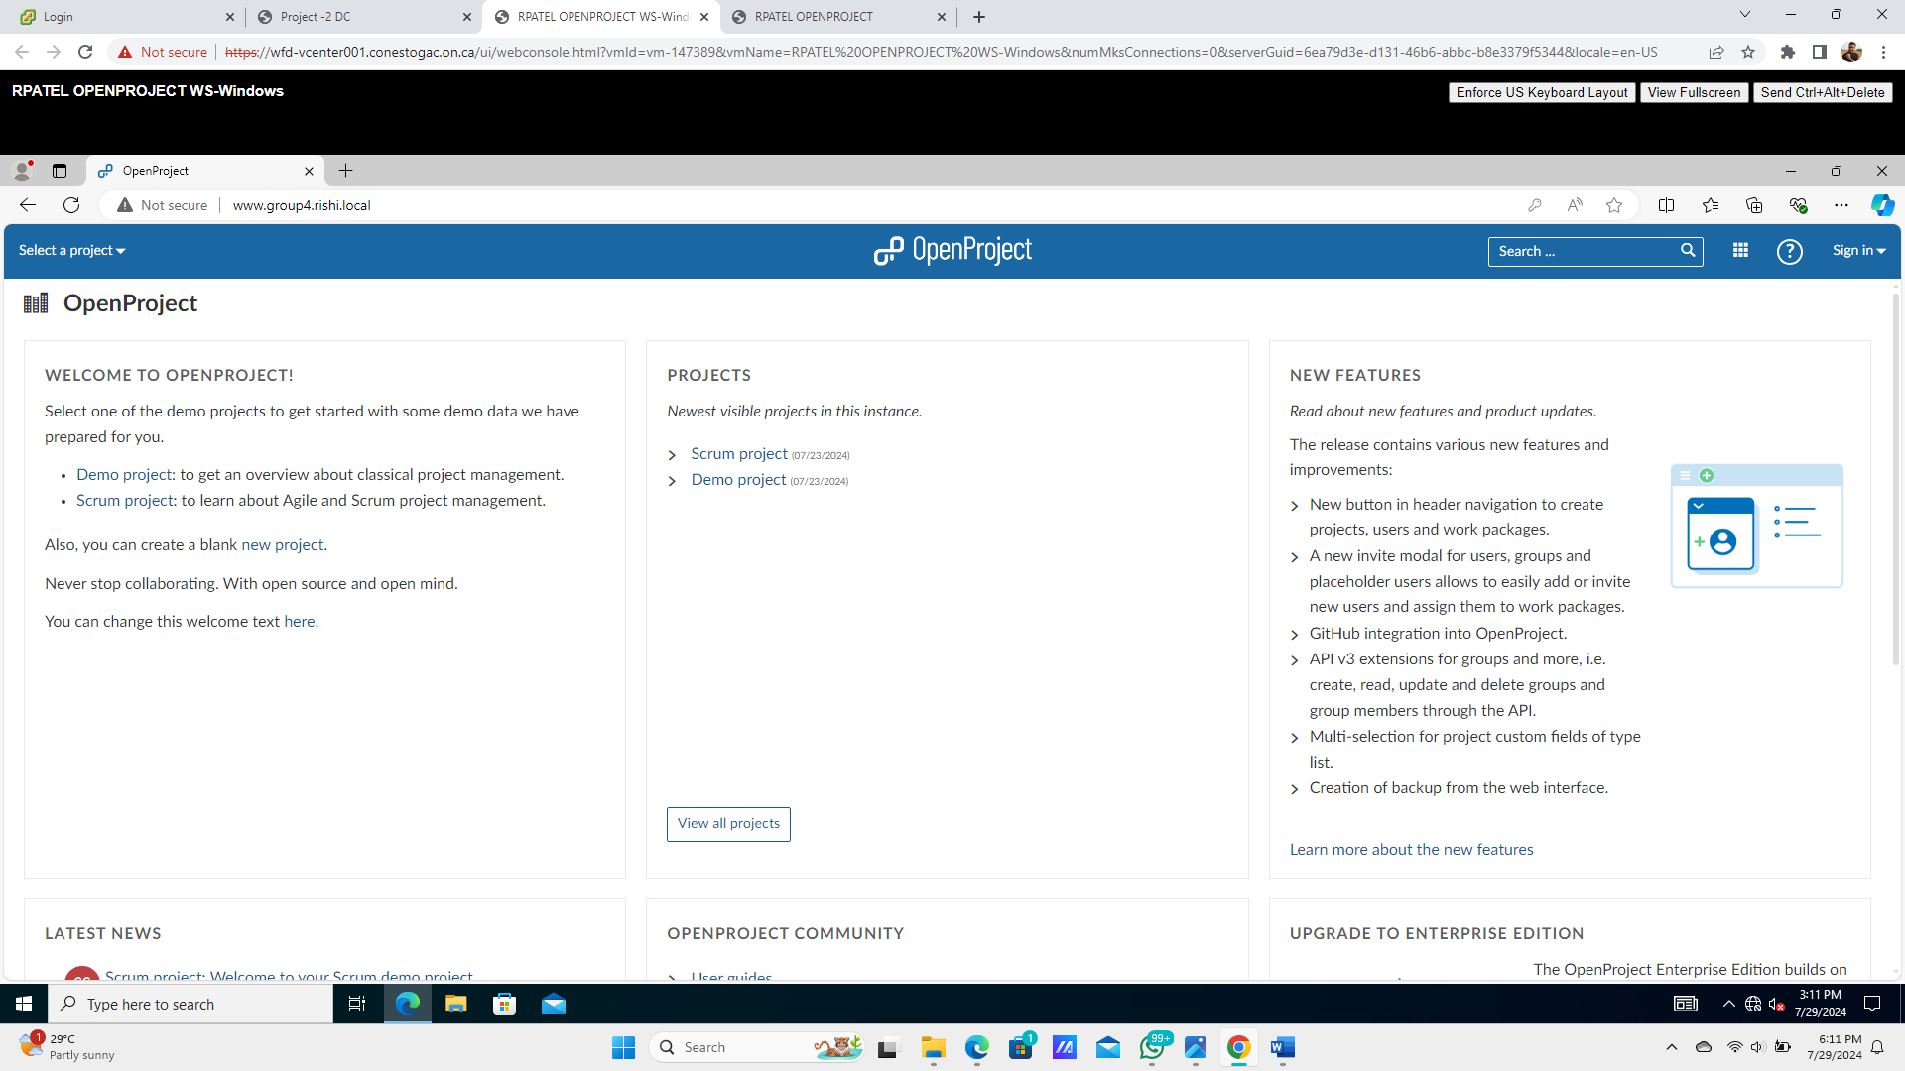
OpenProject Specific Settings
Dashboard Overview of the Open Project Portal

Slide 17
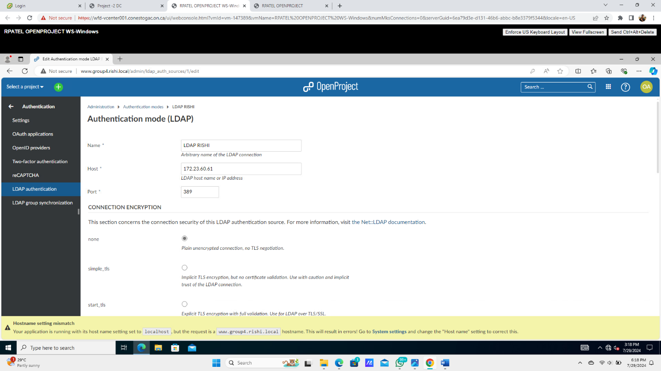
OpenProject Specific Settings
LDAP Authentication Configuration
LDAP configuration are required to integrate the Domain controller and Linux Server.
It will result in the successful login of the AD user in the OpenProject Tool

Slide 18
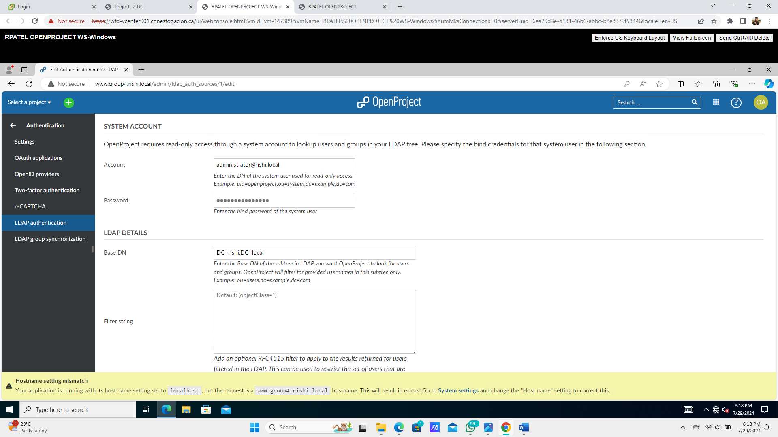
OpenProject Specific Settings
System Account and LDAP Details
AD admin ID and password
Domain name

Slide 19
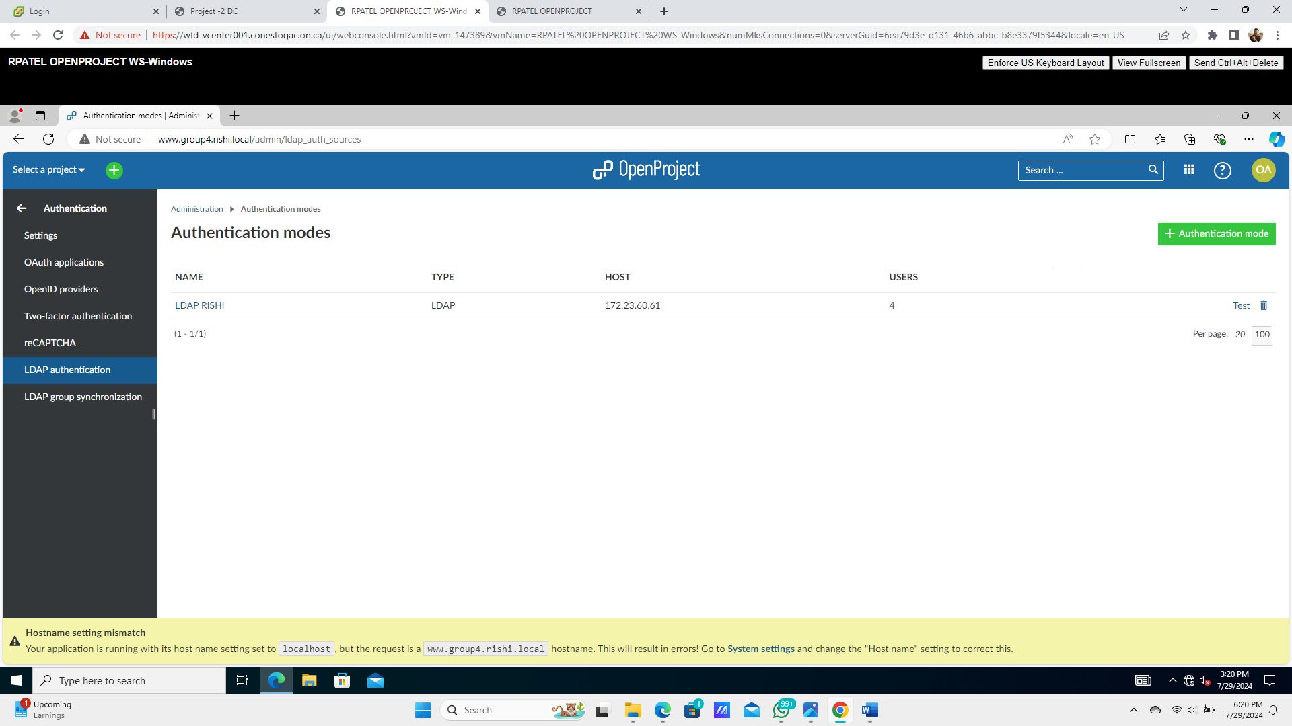
OpenProject Specific Settings
Viewing Authentication Modes
LDAP authentication

Slide 20
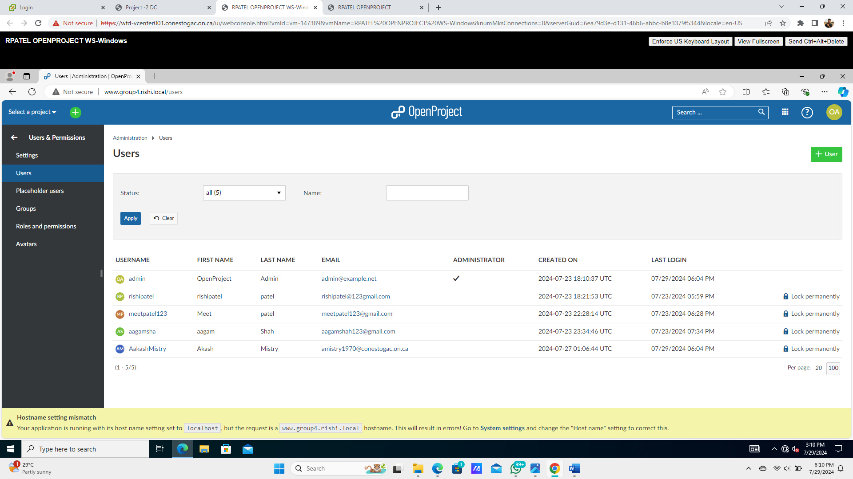
OpenProject Specific Settings
User Account Management

Slide 21
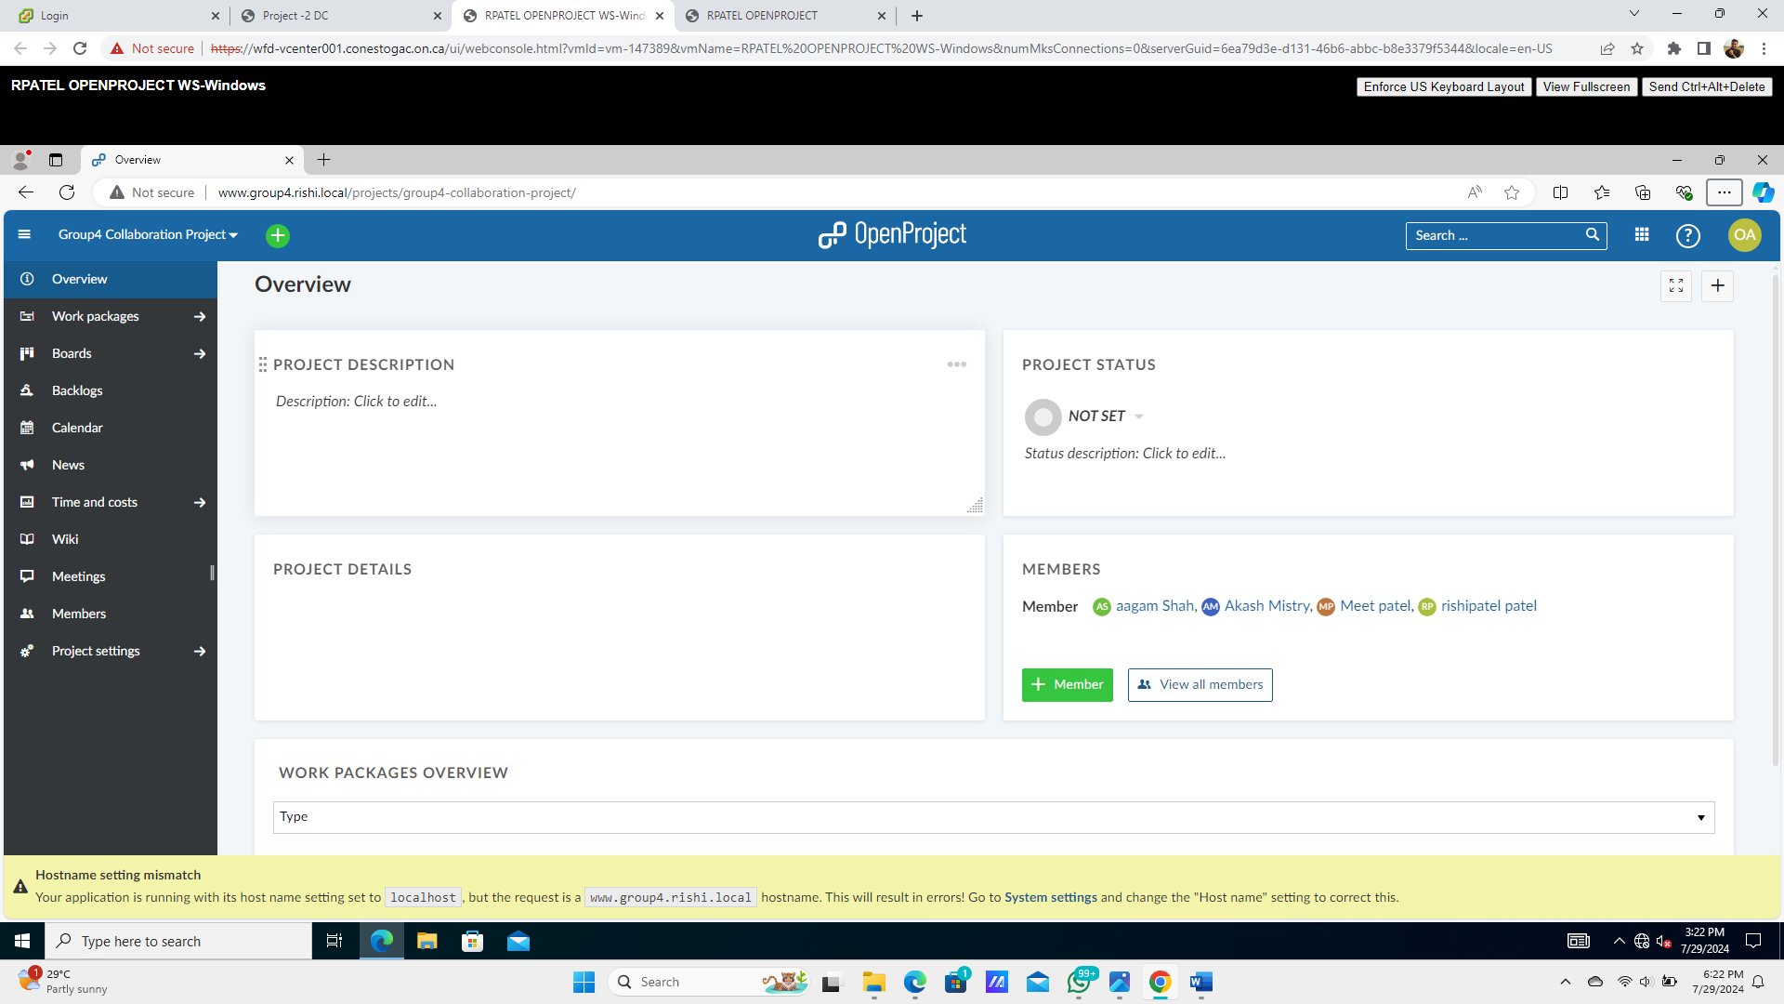
OpenProject Specific Settings
Project Overview and Member Details

Slide 22
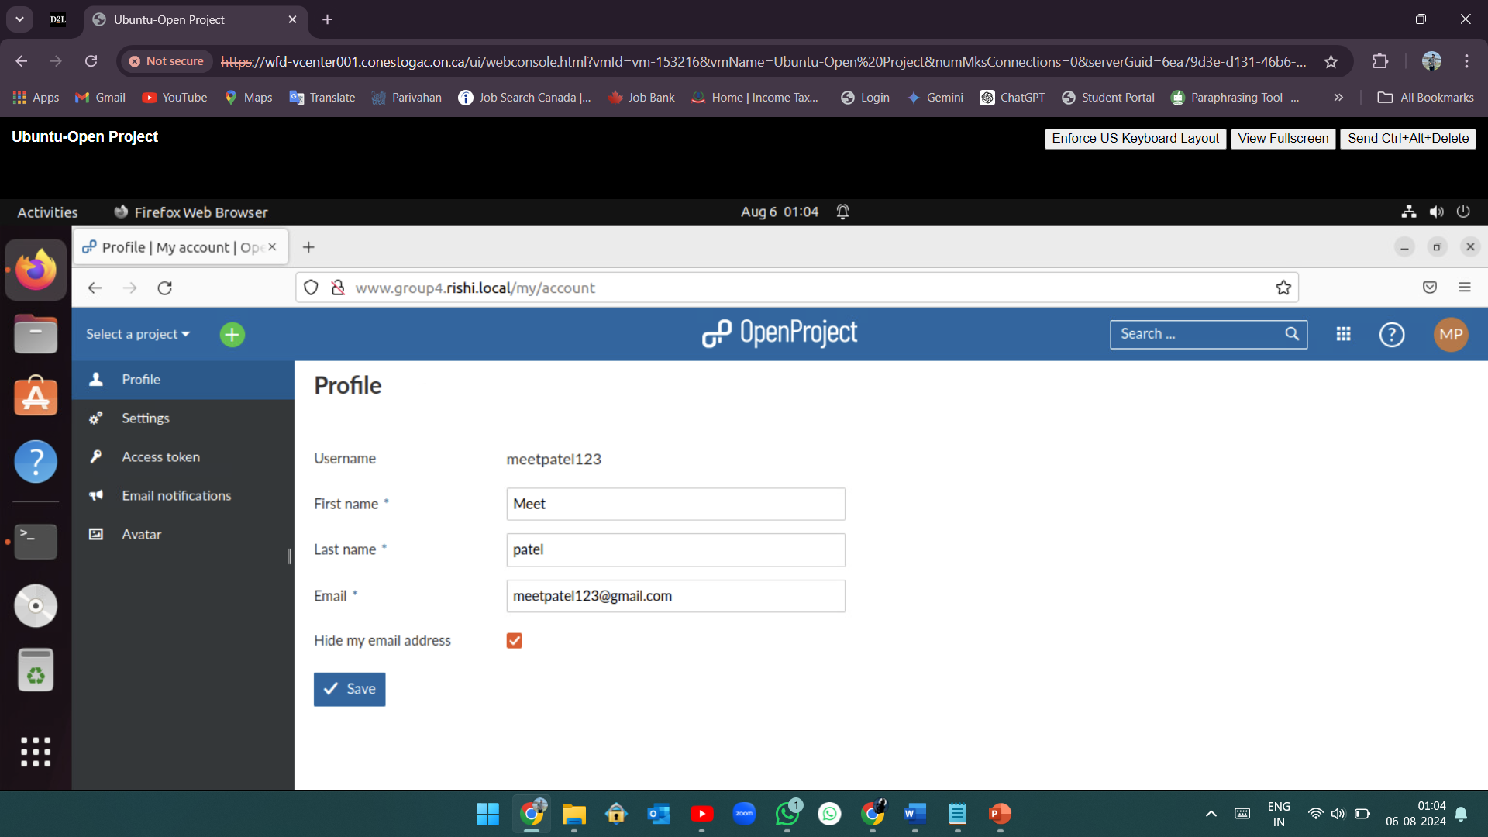
Testing and Validation
Logging into OpenProject Portal From Linux Client Machine

Slide 23
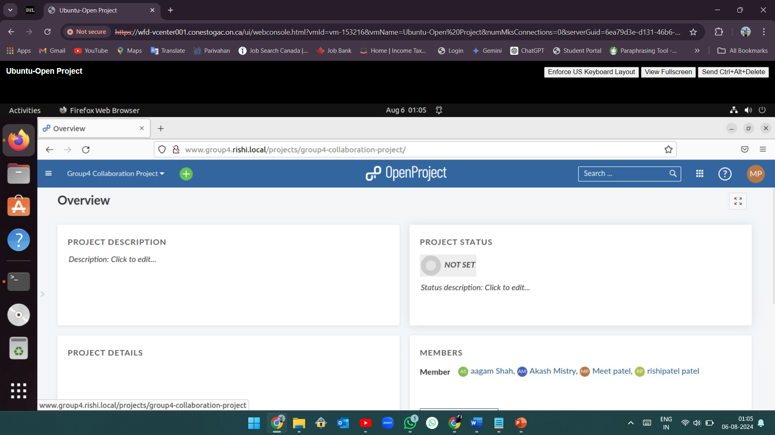
Testing and Validation
Ensuring Proper Functionality

Slide 24
Challenges & Resolutions
Troubleshooting and problem-solving Apache server and Setting up the Firewall
LDAP configuration challenges
Linux connectivity to Domain and user login

Slide 25
Conclusion
Summary of Achievements:
- Successful installation and configuration of OpenProject
- Proper functionality ensured and good user experience.
Successfully Provide Secure and useful Integration tool for all Operating System Users.

Slide 26
Thank You
Thank you for your attention.

